Slide 1
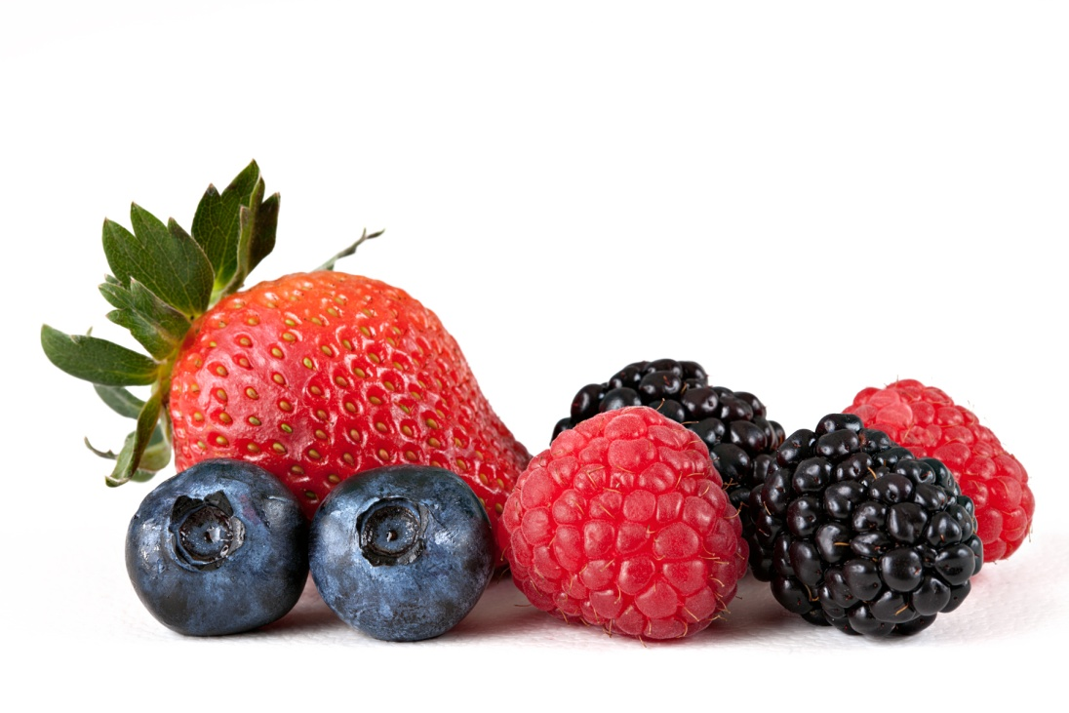
TIPS FOR GETTING KIDS TO EAT HEALTHY ©2012 GRETCHEN SCALPI, RD, CDE

Slide 2
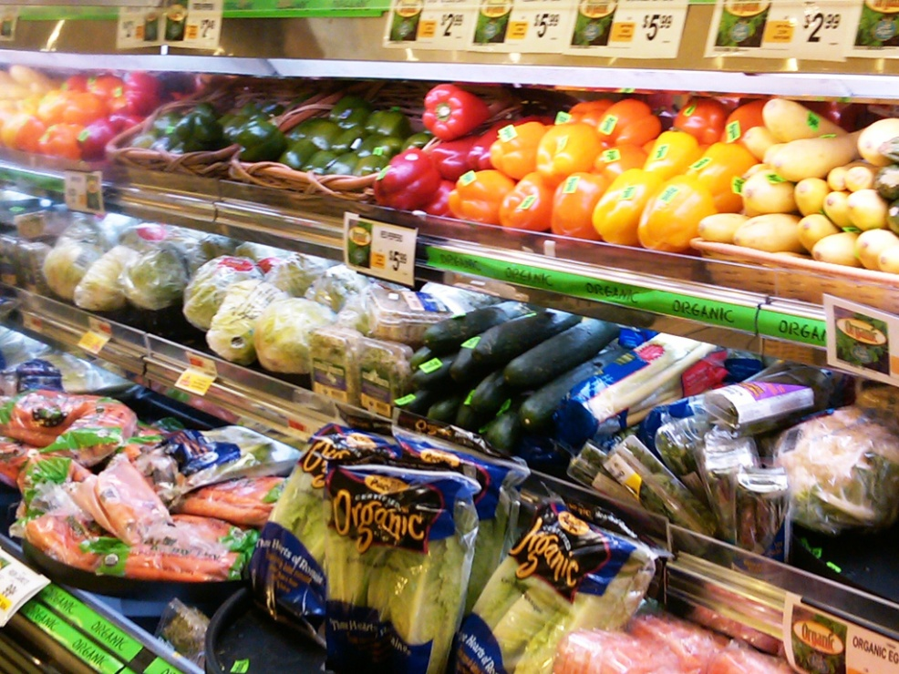
TAKE THEM SHOPPING
Take your children grocery shopping with you! Bring them through the produce section, to the meat and seafood counters, and to the aisles where there are grains and beans.
(source)

Slide 3
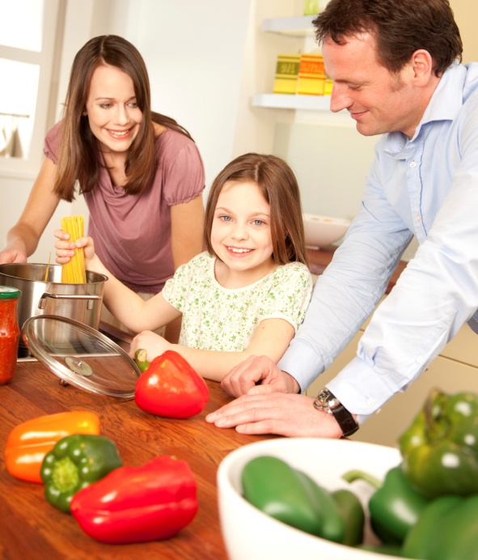
GET THEM INVOLVED
Let your children help prepare meals! They’ll be excited to eat something they’ve made.

Slide 4
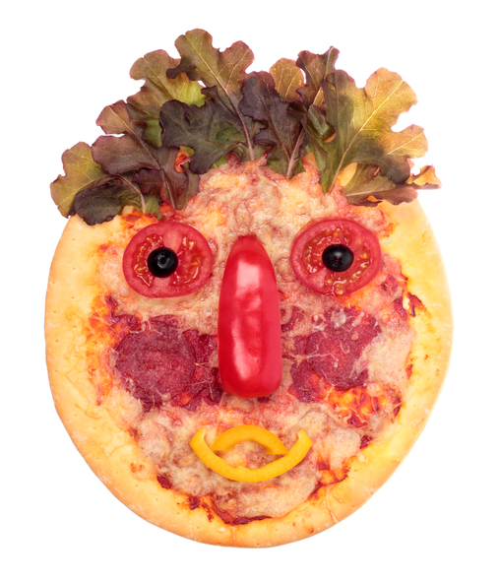
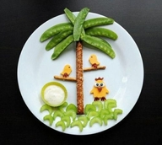
MAKE IT FUN
Kids are drawn to anything colorful and fun! Use a wide variety of fruits and veggies to create colorful dishes. Get creative with plating- make silly faces, flowers, animals, shapes, and whatever you can think of!

Slide 5
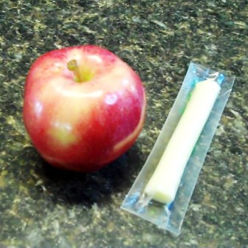
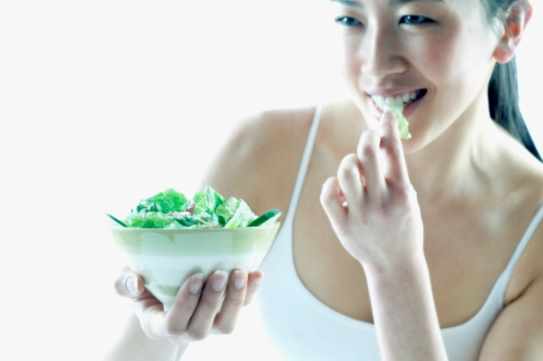
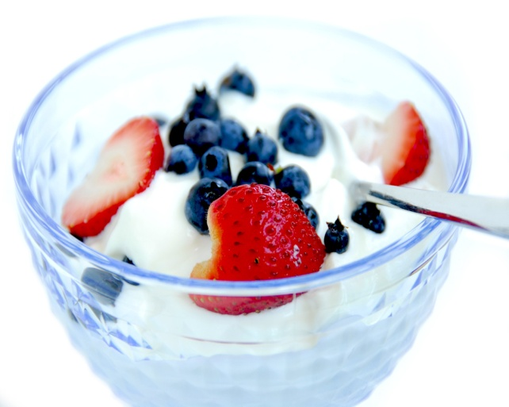
BE PREPARED
Have healthy snacks in sight! Keep a bowl of fresh fruit on the kitchen table, have veggies cut up and ready as an after school snack, or make yogurt parfaits for dessert.

Slide 6
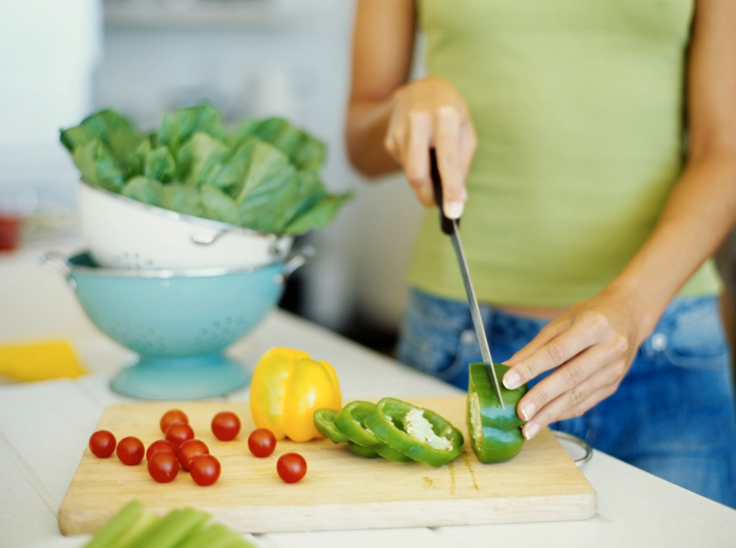
KEEP TRYING
Allow your child to try new foods a few times before saying they don’t like it! Kids’ taste buds are more sensitive than adults’ are, so stronger flavors will take more adjusting to.
(source)

Slide 7
HAVE REGULAR FAMILY MEALS
Lead by example! If your children see you enjoying healthy foods, they will be more willing to try it themselves.
(Source)

Slide 8
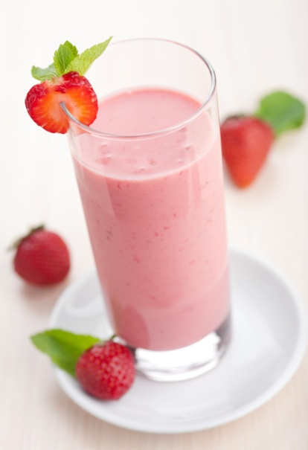
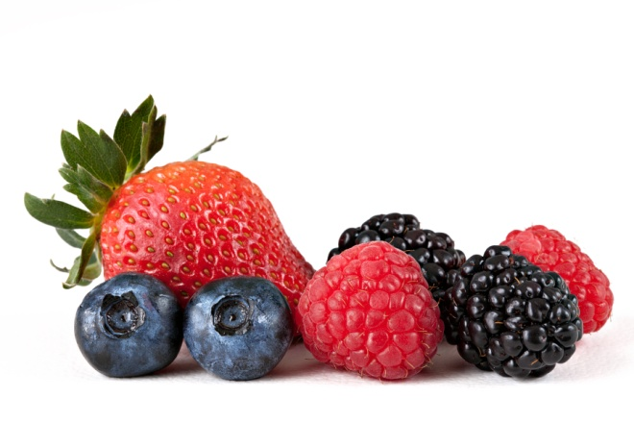
BE CREATIVE
If kids are simply uninterested in healthy foods- get creative and add them into dishes! Add spinach to smoothies, puree carrots and sweet potatoes and add to tomato sauce, and mix berries, flax seed, and wheat germ into pancakes.

Slide 9
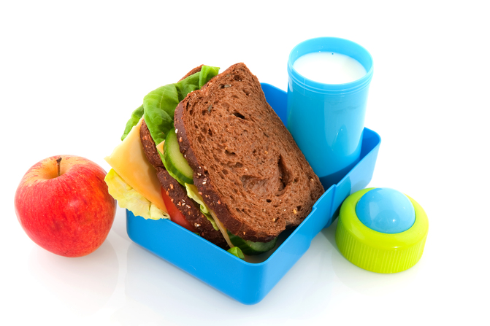
HAVE VARIETY
Having a good variety of foods available allows your child to have a say in what he or she is eating.
(source)
(source)

Slide 10
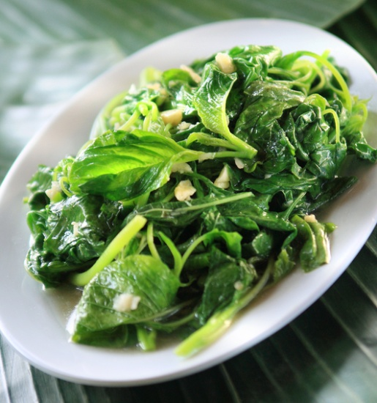
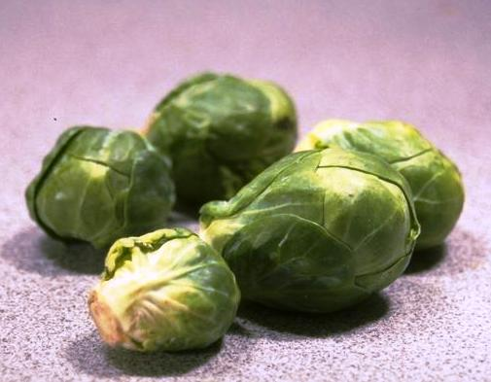
REWARDS/PUNISHMENT
Do not use food as a reward or punishment! Saying no TV until your child has finished his veggies or taking away video games because he won’t eat his greens will make him more resistant to eat them in the future.
(source)

Slide 11
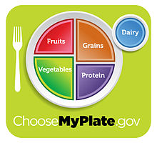
FILL THEIR PLATE
Follow the recommended dietary guidelines for creating healthy plates.
(source)

Slide 12
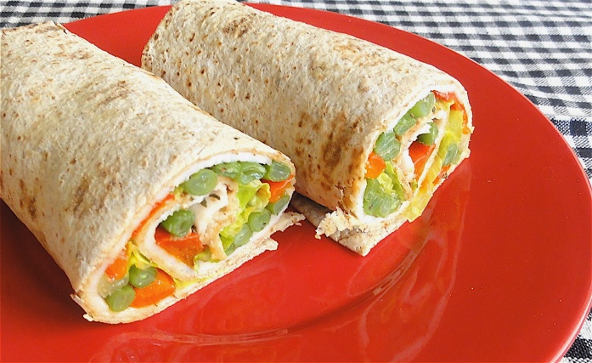
MORE HEALTHY IDEAS
Fruit smoothies made with low-fat yogurt
Dippers: vegetables and hummus, fruit and yogurt
Fruit and veggie kabobs
Whole wheat English muffin/bagel/pita pizzas
Homemade Trail Mix: mixed nuts, dried fruit, whole grain cereals
Create Bento Boxes for lunch
Homemade granola bars
Fruit and cheese plate
Veggie wraps (whole wheat)

Slide 13
Quick Recipe Idea
Strawberry Smoothie or Popsicle
Makes 3 to 4 smoothies, depending on serving size.
1 6-ounce carton vanilla low-fat or fat-free yogurt
3 cups sliced fresh strawberries
1 medium banana, sliced
4 to 8 ice cubes (Note: ice cubes chill and thicken the smoothie)
1. Combine yogurt, strawberries, and banana in blender with the yogurt added first. Cover and blend until smooth; start at a lower speed and gradually increase the speed as the mixture starts to blend and become smooth.
2. With the blender still running, drop ice cubes — one at a time — through the hole in the lid. Blend until smooth and desired thickness. Somewhere between 4 and 8 ice cubes should be about right, depending on the size of cubes.
3. Serve immediately or freeze in popsicle molds to enjoy later.
Source: Alice Henneman, MS, RD, Extension Educator UNL Extension in Lancaster County
Web: www.food.unl.edu ● E-mail: ahenneman1@unl.edu

Slide 14
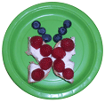
Quick Recipe Idea
Berry Butterfly
Blueberries and raspberries*
Low-fat cream cheese
½ of a whole-wheat mini bagel
Spread cream cheese on bagel. Cut in half.
Have your child decorate with berries!
*Cut berries in half to reduce choking hazard for young children
Source:
Cami Wells, MS, RD, Extension Educator
Email: cwells2@unl.edu • UNL Extension in Hall County

